Slide 1
WELCOME
PRESENTED BY
CHAITALI DHANU

Slide 2
India-Law Pertaining To The Environment

Slide 3
Introduction
The Environment Protection Act, 1986 was Constitutional on 19th November, 1986.
To Provide for the Protection and Improvement of environment and the matter connected with the environment.
According to the act our envirnoment includes :
Water
Forest
Wildlife
Noise
Coastal Zone, Etc

Slide 4
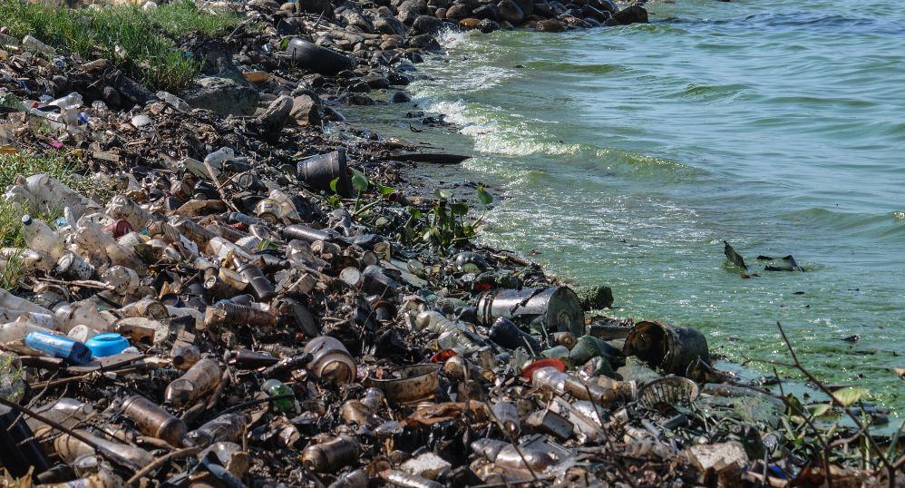
The Environmental Acts and Laws in India are analyzed according to the nature of the problems.
Water Pollution Related:
This act was passed on year 1974 during Indira Gandhi tenure.
It doesn’t need to explain about water. Our India is facing the serious water faculty.

Slide 5
Acts Related to Water Pollution
The Water (Prevention and Control of pollution)Act, 1974, as amended up to 1988.
The Water (Prevention and Control ) of pollution Rules, 1975
The Water (Prevention and Control of Pollution) (Procedure for Trans action of Business) Rules ,1975.
The Water (Prevention and Control of pollution) Cess Act, 1977, as amended by Amendment Act, 1991.
The Water (Prevention and Control of pollution) Cess Rules , 1978.
The Water (Prevention and Control of pollution) Act, 1974, as amended up to 1988.

Slide 6
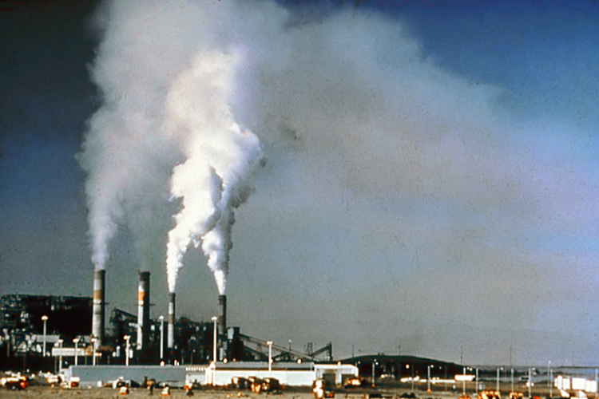
Air Pollution Related :
This Act may be called the Air (Prevention and Control of Pollution) Act, 1981.
It extends to the whole of India.
An Act to provide for the prevention, control and abatement of air pollution.

Slide 7
Acts Related To Air Pollution
The Air (Prevention and Control of Pollution) act, 1981, as amended by Amendment Act, 1987.
The Air (Prevention and Control of Pollution) Rules, 1982.
The Air (Prevention and Control of Pollution) (Union Territories) Rules, 1983.

Slide 8
Noise Pollution Related

Slide 9
Noise is a type of atmospheric pollution in the form of waves. It is a shadowy public enemy.
It has increased in the modern age of industrialisation and technological advancement.
This Act may be called as Noise Pollution (Regulation and Control) Rules, 2000

Slide 10
Noise Pollution Related Acts
Section-2 (A) of the Air (prevention and control of pollution) Act, 1981 includes noise in the definition of “Air Pollution” – This section states Air pollution means any solid, liquid or gaseous substance including noise present in the atmosphere. Such concentration as may be or tend to injuries to human being or other living creatures or plants or property or environment.
Section-2 (C) of the Environment Protection Act, 1986 defines environmental pollution to mean the presence in the environment of any environmental pollutant.

Slide 11
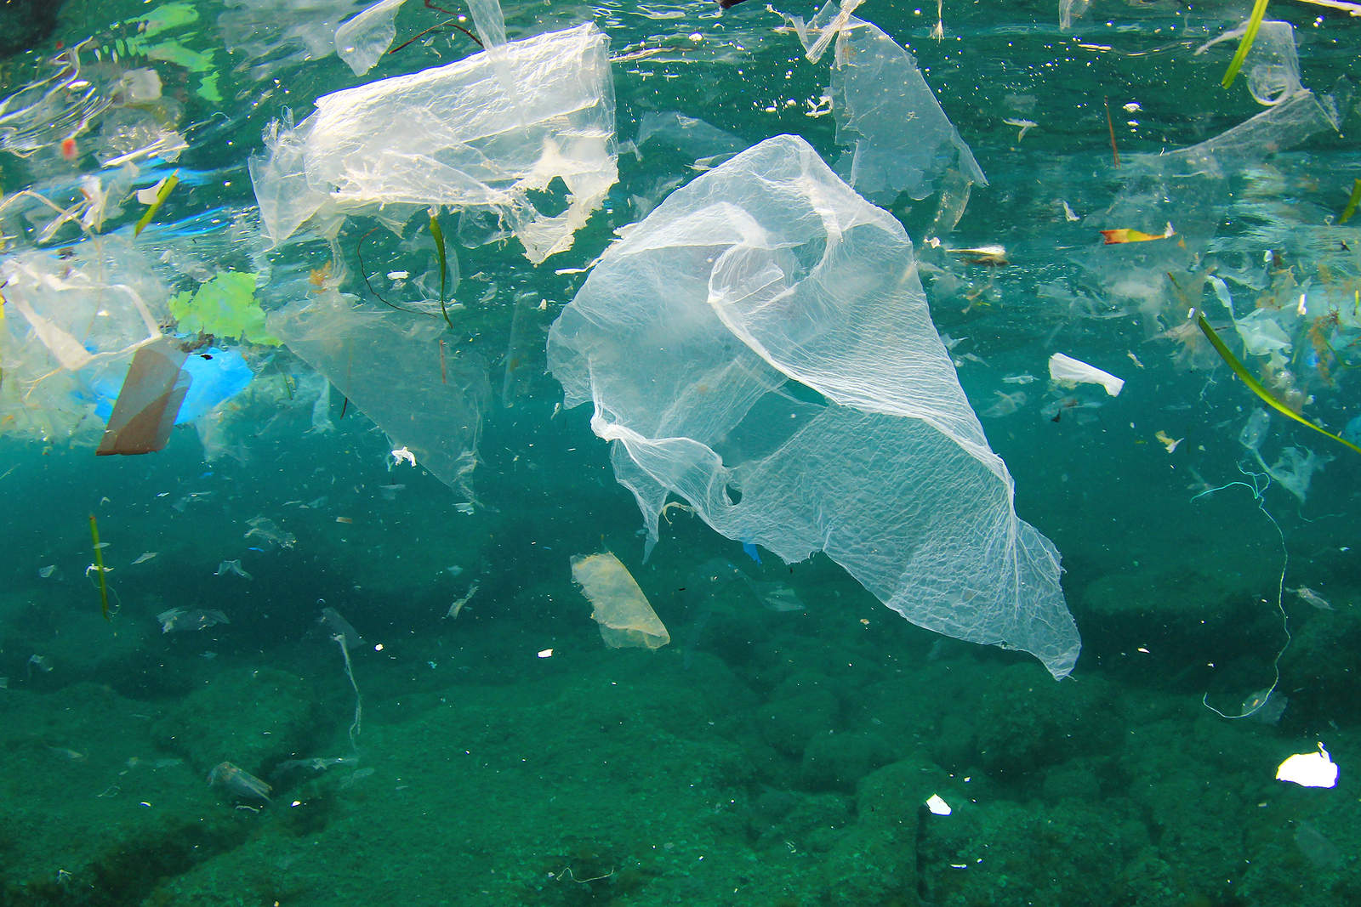
Coastal Zone Related
India lengthy coast stretches over 6,000 kilometers, supporting numerous fishing communities and driving the economies of coastal villages, towns and cities.
The legislative framework for controlling marine pollution is provided by the Territorial Waters, Continental Shelf, Exclusive economic Zone and Other Maritime Zones Act of 1976.

Slide 12
Acts Related to Coastal Zone
Development along coastal streches is severly restricted under a regime comprising the Coastal Regulation Zone (CRZ) Notification of 1991,
The approved Coastal Zone Management Plans (CZMPs) for each state.
Coastal Regulation Zone Notification
Aquaculture Authority Notification
Coastal Zone Management Authority Notifications

Slide 13
Forest Conservation Related
In extending to forests land, which is not the property of the Government,
The Indian Forest Act represents strong Governmental intusion into private rights
The Forest Conservation Act also provide protection and compensation for legally recognized individual or community rights to forest land or forest products.

Slide 14
Acts Related to Forest Conservation
The Indian Forest act, 1927
Forest (Conservation) Act, 1980
Forest (Conservation) Rules, 1981
National Forest Policy, 1988
Guidelines for diversion of forest land

Slide 15
Wildlife Related
For over Century , Indian Wildlife has received sporadic protection through numerous , species – specific statutes.
The Primary Intent of most early statutes was to preserve game animals for hunting.

Slide 16
Acts Related to Wildlife
The Indian Wildlife (Protection) Act, 1972
The Wildlife (Transaction and Taxidermy) Rules, 1973
The Wildlife (Stock Declaration) Central Rules, 1973
The Wildlife (Protection) Licensing (Additional Matters for Consideration) Rules, 1983
Recognition of Zoo Rules 1992 Wildlife (Protection) Rules, 1995
Wildlife (Specified Plants- Conditions for Possession by Licensee) Rules, 1995
Wildlife (Specified Plants Stock Declaration) Central Rules, 1995
Guidelines for Appointment of Honorary Wildlife Wardens.

Slide 17
Thank You

