Slide 1
Class:- FYBCOM Subject :- Commerce –I Chapter 1. Topic:- Introduction to Business
WELCOME STUDENTS

Slide 2
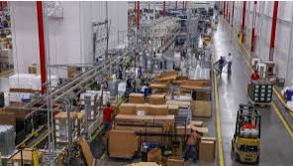
Introduction to Business
Meaning & Concept:-
Business refers to commercial activities relating to production & distribution of goods & services for economic gain (profit).
The true business of every company is to make customers, keep customers & maximise value to customers.

Slide 3
NATURE/ FEATURES/ CHARACTERISTICS OF BUSINESS
Organised Activity:- Business is an organised activity of Identifying, producing, satisfying & thereby gaining profit & if required modifying & innovating to survive.
Profit Motive:- The primary objective of any business to exist is to earn profit. Profit is the reward for the efforts undertaken by a business firm.
Quality Focus:- Business must focus on producing quality goods & give good quality service to earn competitive advantage by ways of Research & Development Department, Customer Satisfaction Survey etc.
Risks & Uncertainties:-Business may be affected by certain internal & external risk such as strike, fire in factory, Recession, Corona etc.

Slide 4
NATURE/ FEATURES/ CHARACTERISTICS OF BUSINESS
Social Responsibility:-Business has certain responsibilities toward the society (stakeholders) that impact/affect the business such as Employees – fair wages, Customer – quality product, Govt – pay taxes
Creative & Dynamic:-Business needs to come up with creative ideas, goods & services to win competitive advantage & survive in today ever changing market.
Customer Satisfaction:- Business firms can provide customer satisfaction only when the product performance matched with the customers expectations.

Slide 5
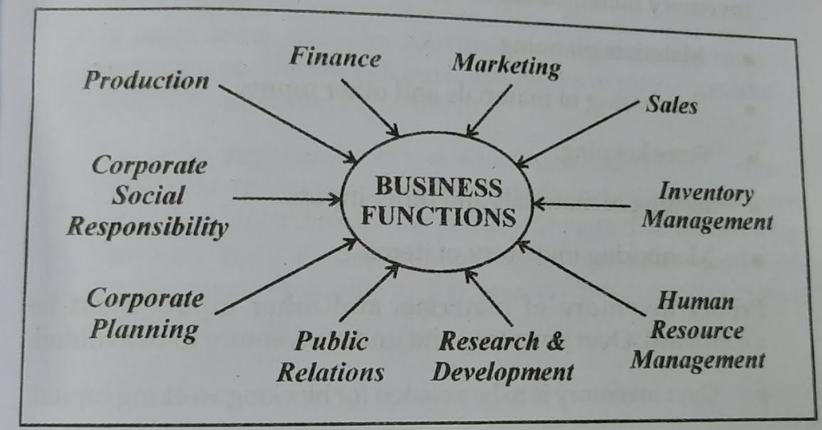
FUNCTIONS OF BUSINESS
A business for smooth conducts of various business activities, there is a need to perform certain functions.

Slide 6
FUNCTIONS OF BUSINESS
Production Function:- It refers to converting raw material into finished product. Thus this function of business Creates form utility.
Inventory Management:-It refers to management of inventory such as raw material, semi-finished goods, finished goods, spare parts etc. There should be no over inventory or under inventory situation in business
Marketing Function:- It refers to the product, price, place & promotion of goods & services & creating a brand name & satisfy & survive in business.
Sale Function:-It is concerned with the selling activities of the firm i.e. taking orders & distributing them. Its an operational function whereas marketing is a planning function.
Finance Function:- Its refers to activities relating to planning, obtaining (sourcing), utilizing & controlling of funds in a business.

Slide 7
FUNCTIONS OF BUSINESS
6. Human Resource Management:- It refers to the management of people in the organisation i.e. planning, recruiting, selecting, training, appraisals, promotion, transfer, compensation etc.
7. Research & Development:- It refers to all activities conducting it creating & innovating new products & services & finding out ways to modify the existing products, procedures & services.
8. Public Relations:- It refers to the business firms maintaining good relations with the stakeholders & outsiders & informing & updating them with firm business.
9. Corporate Planning:- It includes activities such as analysis internal & external environment, Setting objectives & goals, framing startegies (ways), implementing (fulfilling)strategy & reviewing the performance.
10. Corporate Social Responsibility :- It refers to a concept where companies combine social & environmental concerns in their business operations.

Slide 8
SCOPE/ ELEMENTS / AREAS OF BUSINESS
Business activities are classifies into two groups:-

Slide 9
INDUSTRY
Industry is concerned with the production of goods & services.
Industry represents the supply side i.e supply of goods & services to meet demands of customers.

